Slide 1
Are Mexicans Leaving the United States and Heading Home ?
Country build by british colonies
Since 1840, lot of immigrants
Now, a decrease of their number

Slide 2

I : Imigrants history in USA
1) the first comer
2) political escape
3) immigration act
II : the neighbor imigrants : the mexican
1) the first arrived
2) their job in US
3) reasons of decrease
1840 – 1860
  English & Irish :
    ( Potatoes famine )
  German, Dutch
    ( unemployment, poverty )
  ► better wages ( salaire )
1860 – 1880
  The chinese
    ( unable to raise their children )
  ► build rail roads
  ► full of hopes and dreams

Slide 3
I : Imigrants history in USA
1) the first comer
2) political escape
3) immigration act
II : the neighbor imigrants : the mexican
1) the first arrived
2) their job in US
3) reasons of decrease
1880 - 1900
  Italians, Poles, Russians
  ►find a religious and political freedom
1900 – 1920
  Easter Europeans
    ( Fleeing war and revolution )
  ► for an easier life

Slide 4
I : Imigrants history in USA
1) the first comer
2) political escape
3) immigration act
II : the neighbor imigrants : the mexican
1) the first arrived
2) their job in US
3) reasons of decrease
Act of 1917
  Excluded all Asian
National Origins Act
  Quotas for each country outside
Act of 1965
  - Refugees were adimited as immigrants

Slide 5
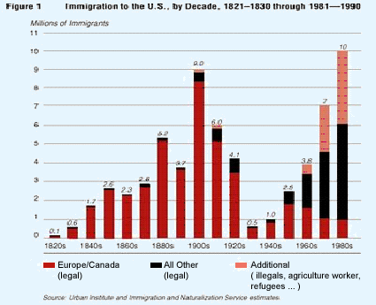
Number of Immigrants to the US per Decade

Slide 6
I : Imigrants history in USA
1) the first comer
2) political escape
3) immigration act
II : the neighbor imigrants : the mexican
1) the first arrived
2) their job in US
3) reasons of decrease
Begin during the great depression
  USA winner of the WW2
Admit war refugees
  From 1953 to 1955
  2,2 M Mexicans

Slide 7
I : Imigrants history in USA
1) the first comer
2) political escape
3) immigration act
II : the neighbor imigrants : the mexican
1) the first arrived
2) their job in US
3) reasons of decrease
The aims
  To provide their family
  Realise their dream
  ► live another life
Kind of jobs
  mainly : laborers
  In factories : chain works
  ► with few marketable skills

Slide 8
I : Imigrants history in USA
1) the first comer
2) political escape
3) immigration act
II : the neighbor imigrants : the mexican
1) the first arrived
2) their job in US
3) reasons of decrease
Economy situation in US
  Since 2008
  Less and less jobs
Difficulties to cross the borders
  Patrols prevent illegal entries
  Risk their life

Slide 9
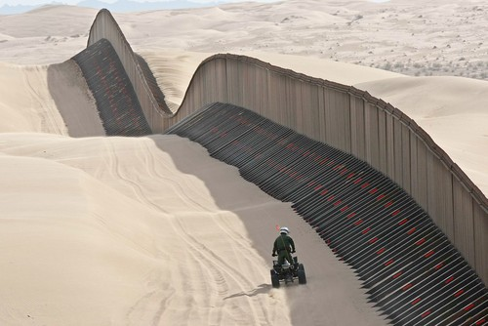
An agent patrolling along the border

